Slide 1

Exploratory Data Analysis of Tesla Inc. Stock Price

Slide 2
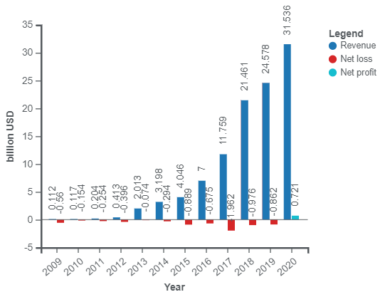
Tesla Inc. Overview
Founded by Elon Musk and 4 others in 2003
Current products include electric cars, battery energy storage from home to grid scale
Market leader in electric mobilities
Accounted for ~80% of all battery electric car registrations in the U.S
Financial Performance
History and Product information

Slide 3
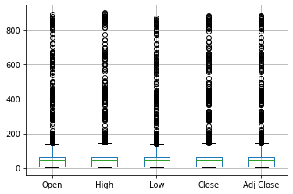
Stock Price: Statistical Summary: Nov ‘16- Feb’21
 | Open | High | Low | Close | Adj Close | Volume | daily_percent_change
count | 2676 | 2676 | 2676 | 2676 | 2676 | 2676 | 2675
mean | 69.1157 | 70.63432 | 67.54958 | 69.21707 | 69.21707 | 31775031.39 | 0.12961522
std | 122.3529 | 125.2744 | 119.341 | 122.7329 | 122.7329 | 29163113.04 | 3.540031553
min | 3.228 | 3.326 | 2.996 | 3.16 | 3.16 | 592500 | -26.68302547
25% | 7.573 | 7.688 | 7.406 | 7.5715 | 7.5715 | 11298000 | -1.504203592
50% | 44.636 | 45.442 | 43.928 | 44.627 | 44.627 | 25044250 | 0.121916691
75% | 61.302 | 62.293 | 60.1415 | 61.4125 | 61.4125 | 41086875 | 1.886901294
max | 891.38 | 900.4 | 871.6 | 883.09 | 883.09 | 304694000 | 19.61095101

Slide 4
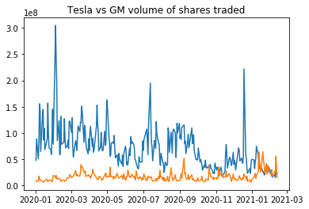
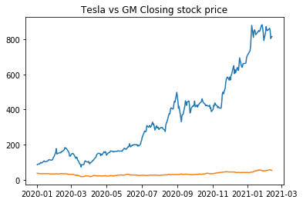
Stock price trends- Tesla vs GM
Tesla exceeds GM in market interest on daily volume basis as well
“For every $ invested in Tesla share in Jan 2020, the stock returned $8 in market value”
General Motors for the same period returned $1.4

Slide 5
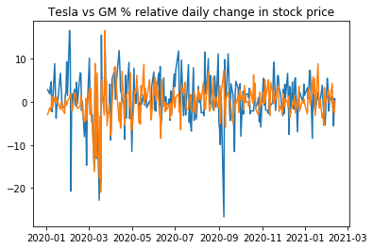
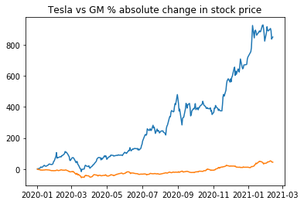
Exploratory data analysis
Daily price changes(in %)
Tesla shows greater volatility with sharper spikes
Cumulative changes since Jan 2020

Slide 6

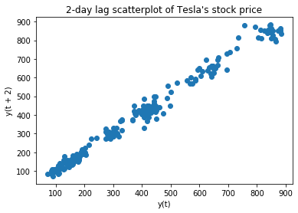
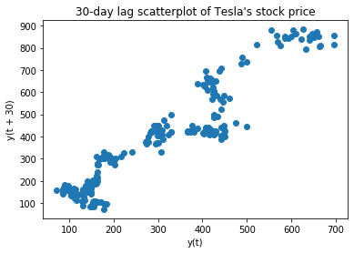
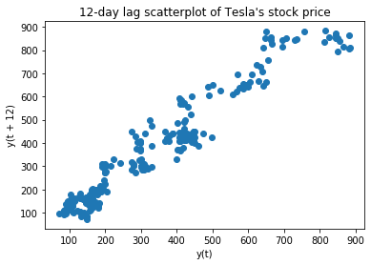
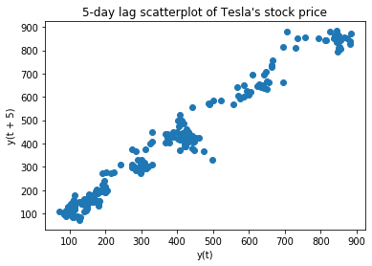
Lag Scatterplot for Tesla
2, 5, 12, 30-day scatterplots show reducing positive correlation between instantaneous and lag values
The trend remains strong, but the divergence of values is directly proportional to lag magnitude

